Slide 1

Estimating genetic diversity and population information from short read (ddRAD-seq) type data
Chris Barratt (sDiv / Evolution and Adaptation)
Laura Mendez (Evolution and Adaptation)
Assistant: Dimas Calderon (Evolution and Adaptation)
20-21 June 2022

Slide 2
Objectives
Understand best practices on planning and executing a population genomics project based on ddRAD-seq (short read) type data
Learn how to download genomic sequence data from the European Nucleotide Archive
Familiarise yourself with the Stacks 2 bioinformatics pipeline to process raw reads
Be able to generate your own output files after Stacks 2 processing for downstream analyses of population structure, phylogeny and genetic diversity
Run analyses to perform (Admixture, sNMF, DAPC, RAxML, F-statistics), understand what you’ve done and how to interpret the outputs

Slide 3
Schedule
Day 1 (20th June): 09:00 - 15:00
Brief introductions and research topics of course leaders and course participants (2-3 mins each)
Introductory lecture on population genomics and ddRAD-seq and which kinds of questions can be answered with these data
Hands on session for downloading publicly available genomic data (e.g. from the European Nucleotide Archive)
Stacks 2 lecture (main processing steps)
Hands on session for each of the major processing steps required for the Stacks 2 pipeline (process_radtags, denovo_map)
Day 2 (21st June): 09:00 - 15:00 (?)
Hands on sessions to analyse population structure, phylogeny and genetic diversity:
Admixture (pop structure)
sNMF (pop structure)
DAPC (pop structure)
RAxML (phylogenetic relationships)
F-stats (FST, nucleotide diversity)

Slide 4
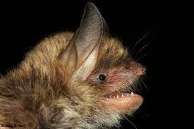
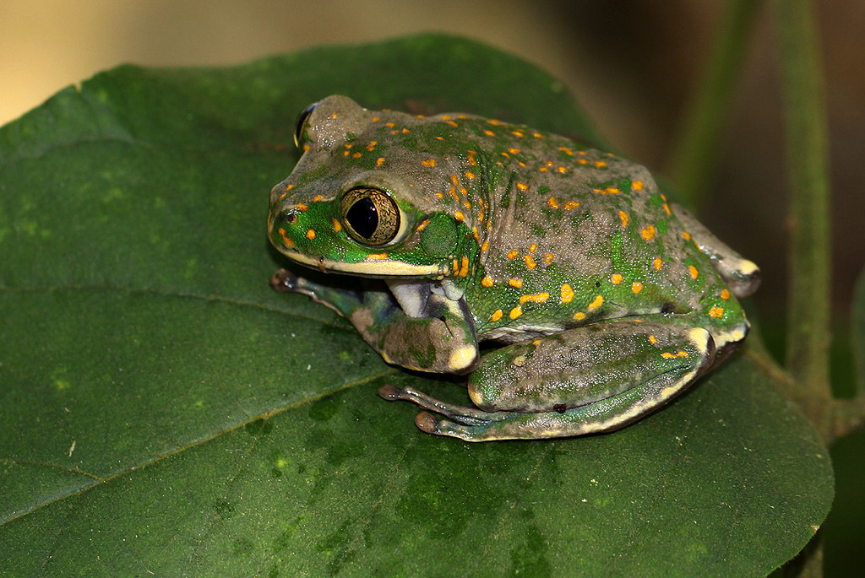
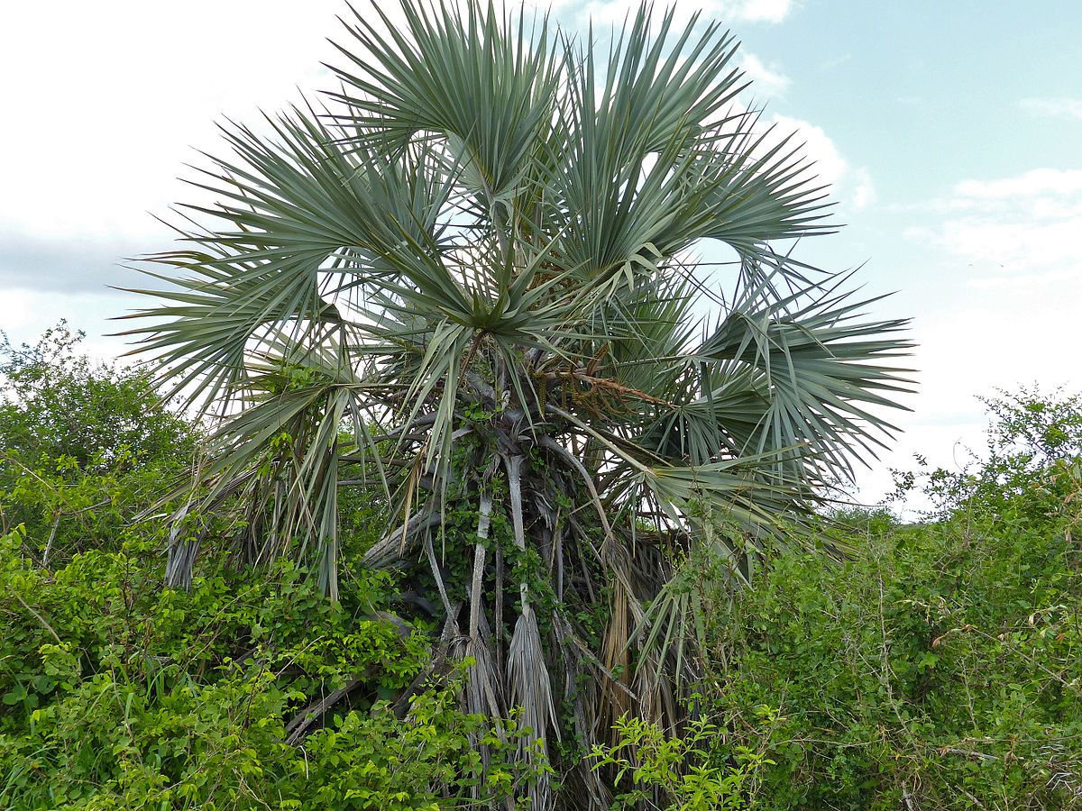
Datasets we will use
We ran a similar course 2019 – the main aim of the course is to get you confident enough to go from raw data to interpreting outputs from analyses. So ask questions!
Myotis escalerai
Leptopelis flavomaculatus
Hyphaene coriacea

Slide 5
What are we doing?
High-throughput data and ddRAD-seq background – what is it and why use it?
Sampling strategy prior to RAD-seq type work – how should I plan my sequencing?
Bioinformatics to generate output files with a HPC cluster using Stacks 2
More specific workshops to follow late 2022 depending on demand (most probably demographic history/local adaptation and Genotype-Environment Association analyses)

Slide 6
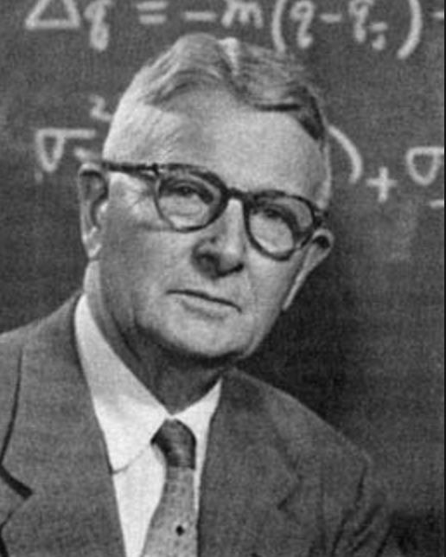
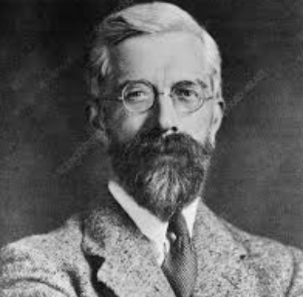
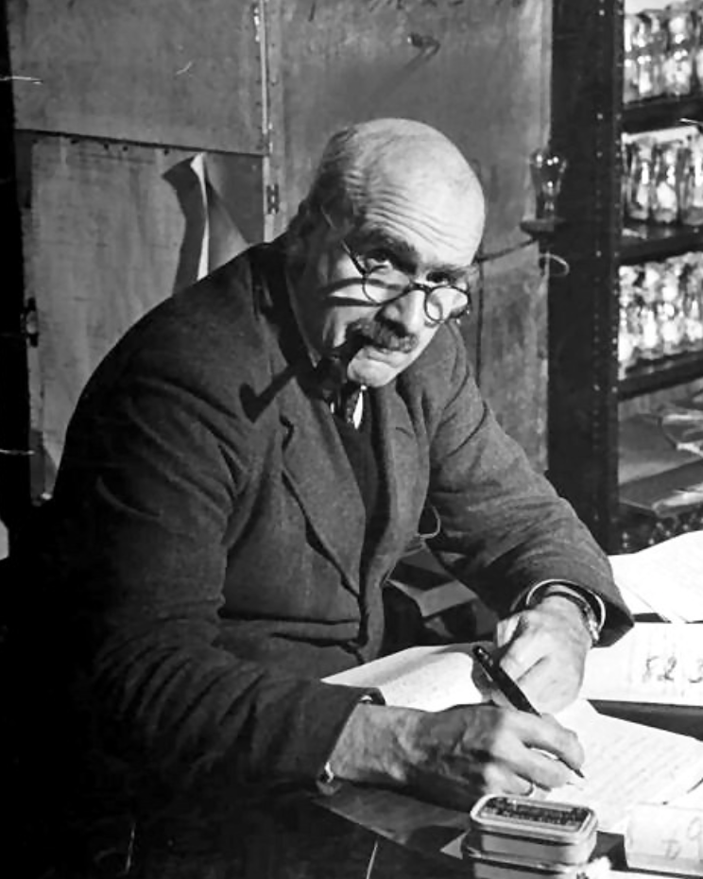
Population genetics history
See Wright, Fisher, Haldane in the early-mid 19th century:
Genetic composition of populations
Changes in genotypes in response to the four evolutionary forces (drift, natural selection, gene flow and mutation)
Markers have gradually become more numerous and associated methods more sophisticated:
- Allozymes - AFLPs - microsatellites - SNPs (Single Nucleotide Polymorphisms)
- Whole genomes

Slide 7
Genetics vs. Genomics
Genetic data (e.g. nuclear loci, mtDNA, chloroplast DNA)
AGCTACGCTACGACTACGATCACGCGATCCGAGAGAGAGAGCGACTCAGACTACCCCAAC
Genomic data (e.g. WGS, Exon capture, [dd]RAD-seq)
WGS
Exon capture
[dd]RAD-seq
SNP datasets

Slide 8
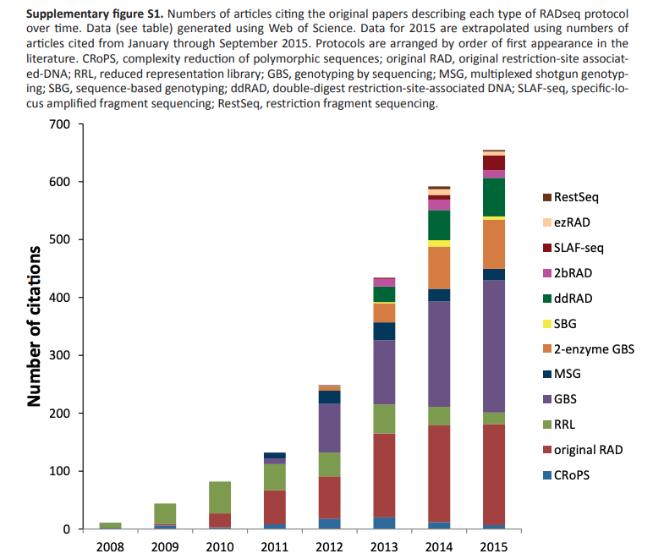
Reduced Library Representation
Huge increase over time

Slide 9
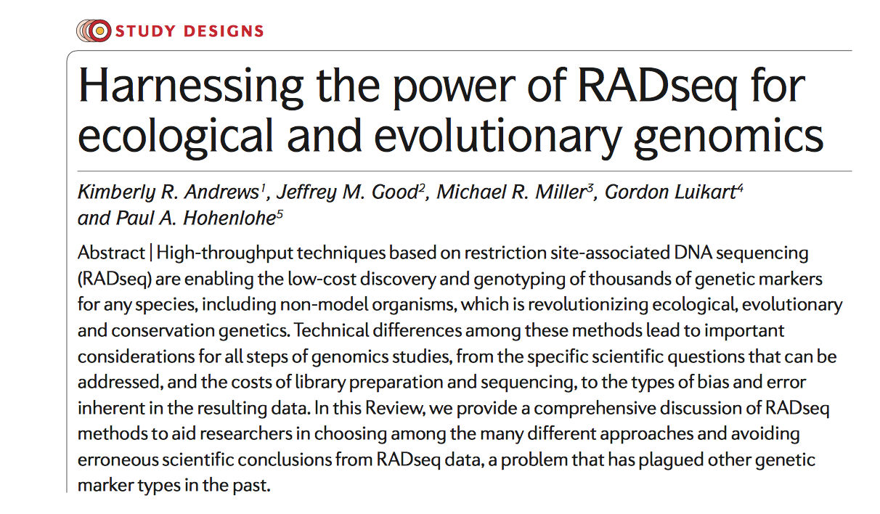
ddRAD-seq
Positives
Large data
Quick data generation
Pooling of individuals
High resolution
Powerful inference
Cost effective
Negatives
Laboratory investment (adapters, equipment such as sonicator or
Pippin prep)
Bioinformatic investment – HPC use,
also learning how to process data

Slide 10
RAD-seq
denovo_map.pl

Slide 11
ddRAD-seq
Figure 2. Double digest RAD sequencing improves efficiency and robustness while minimizing cost.
(A) Traditional Restriction-Site Associated DNA sequencing (RADseq) uses a single restriction enzyme (RE) digest coupled with secondary random fragmentation and broad size selection to generate reduced representation libraries consisting of all genomic regions adjacent to the RE cut site (red segments). (B) Double digest RAD sequencing (ddRADseq), by contrast, uses a two enzyme double digest followed by precise size selection that excludes regions flanked by either [a] very close or [b] very distant RE recognition sites, recovering a library consisting of only fragments close to the target size (red segments). Representation in this library is expected to be inversely proportional to deviation from the size-selection target, thus read counts across regions are expected to be correlated between individuals (yellow and green bars).

Slide 12
- Conceptualize sequence space… - Number of samples and populations? - Restriction enzyme(s) selected - DNA quality
Sampling design
Genome considerations: (you can’t control this…)
- Genome size, GC content? - Repetitive elements? - Ploidy? - Reference genome?
Sampling considerations: (but you can control this…)

Slide 13
Genome considerations
Smaller is generally better - gives higher coverage of loci as less restriction sites in a smaller genome, so they are sequenced more often per individual
Few repetitive elements (paralogs) better, genome duplications pose additional bioinformatic challenges
Diploid organisms generally easier- most software written to deal with this though there are workarounds (e.g. dDocent)

Slide 14
Sampling considerations
What are your questions? Pop structure/Phylogeny/Demography – this will dictate how many individuals/populations you need to sequence in your sampling strategy
RAD-seq uses a rare cutter enzyme (e.g. sbfI, EcoRI, Pstl), ddRAD introduces a frequent cutter too (e.g. MspI, MboI) – think about which to use to maximise the information you will get
DNA quality is CRUCIAL! ddRAD in particular needs very high quality DNA, RAD-seq can deal with degraded samples better. You need ACCURATE quantification of ALL samples prior to any labwork. Samples will compete for sequence reads so try to have a working concentration (x ng/ul) across all samples. Run samples on a gel and also use Qubit to measure e.g. 3x and take average

Slide 15
In the lab…
Quantify your DNA and samples prior to organising RAD library construction (don’t do all together). Bring 96- plates with your DNA aliquots to lab and do protocols there
Intense concentration needed, but relaxed periods in between (e.g. waiting for PCR / gel steps), so keep alert. One small mistake can ruin hours/days of work!
Be exceptionally consistent and accurate with pipetting especially at the adapter ligation stages – this will determine if individuals are included in your library when pooling. Also be careful with extracting the gel slices, size selection is very important

Slide 16
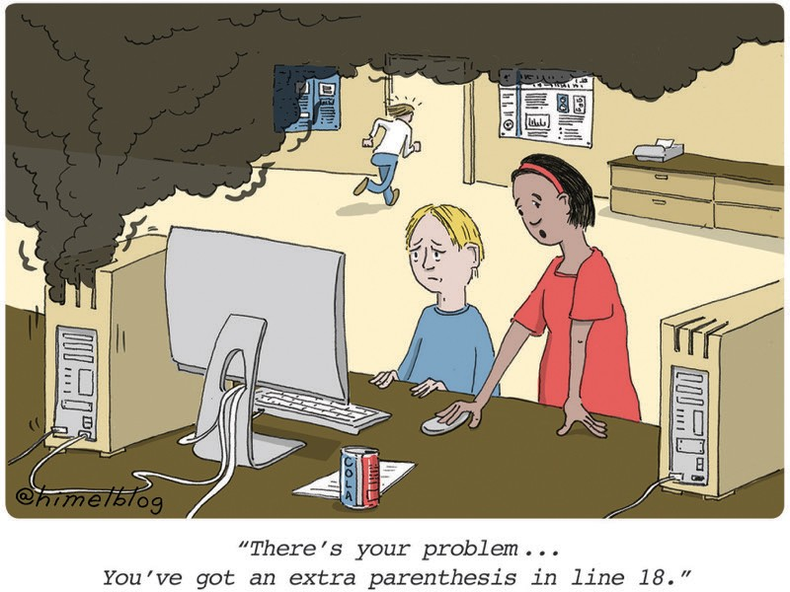

Sequencing
It’s wise to run samples on a Bioanalyzer to check the size of the fragments in the final library, sequencing facilities can do this but will charge
Once your libaries are done you can store them in the fridge/freezer until ready to take to the sequencing facility
Enjoy that feeling once it’s all done and take a break before…

Slide 17
Bioinformatics
“Bioinformatics” is an extremely broad subject – covers all types of different analyses. For RAD-seq type data the options are usually Stacks, ipyRAD, dDocent, TASSEL, ANGSD to process data
Downstream analyses will typically use output files from these programs but there are numerous conversion tools if needed (PLINK, PGDSpider)
Absolutely NOT trivial! You need to become familiar with writing code in for linux/unix style environments to do the heavy lifting for you
Also you need to become with High Performance Computing clusters and how to use them as this will be fundamental to parallelising the workload on multiple processors

Slide 18
Stacks
Programmed and maintained by Julian Catchen
Designed specifically for short read [dd]RAD-seq type data
Written in C++ and Perl
Well established pipeline which has not changed too much, cited many times
Good google user group (very useful!)
Denovo_map.pl, ref_map.pl or modular system (process_radtags, ustacks, cstacks, sstacks, populations) - can rerun any part
Stacks 2 much improved for paired end data especially, very good software

Slide 19
Workflow
ddRAD-seq
raw sequence read data
HPC cluster
Stacks 2.61
Perl
Demultiplex
Cluster reads
Build catalogue
Match catalogue
Assemble datasets
Output files for
pop structure, genetic diversity and phylogenetics
Laura will talk about this more!

Slide 20
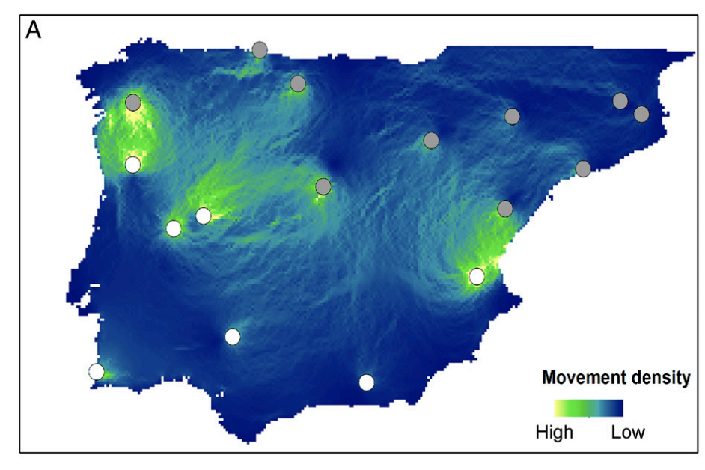
process_radtags
Myotis escalarai – Escalara’s mouse-eared bat
We will download data and then process them
Taking sequenced library and demultiplexig based on individual barcodes (Razgour et al. 2019)

Slide 21
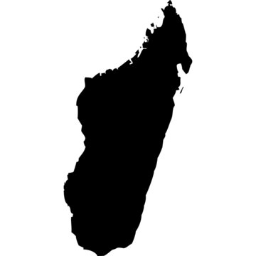
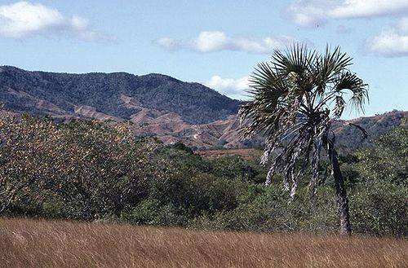
denovo_map
Hyphaene coriacea – a Malagasy palm (Mendez et al. in prep)
We will run denovo_map on some samples so you can see how to process data in Stacks

Slide 22
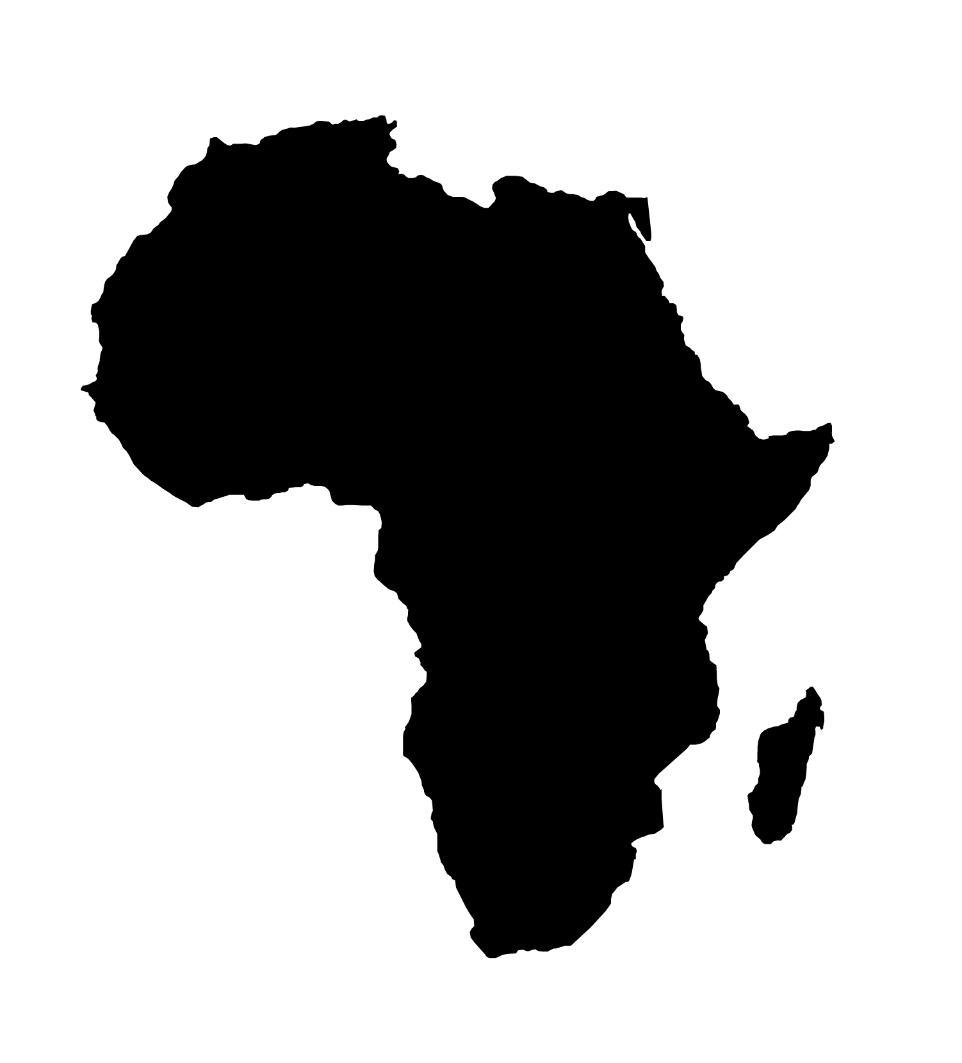
Downstream analyses
Leptopelis flavomaculatus – an East African treefrog (Barratt et al. 2018)
We will look at pop structure, phylogeny and genetic diversity (and FST)

Slide 23
Shell scripts for job submission
Shell scripts let you send your jobs to the HPC cluster
Usually one script per individual task, though you can make special scripts which will submit multiple jobs in sequence
I have a main script header which I edit for each individual job:
Job name
Notifications (starts, ends, aborts, pauses etc.) and email address where to send them
Input/Output directories and where to place job logfile
Requirements – processors needed, amount of memory per processor and runtime (used for queueing)
Followed by the main lines of code – load programs/environments and relevant instructions

Slide 24
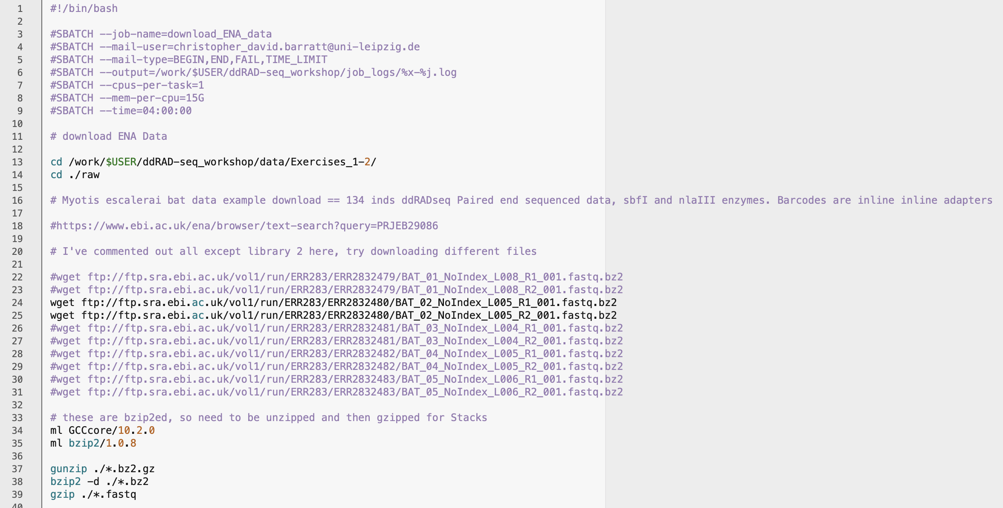
Shell scripts

Slide 25
Stacks pipeline
Demultiplex (all data) – feed in adapter barcodes to get *.fq.gz file per individual (only run once per dataset)
process_radtags
ustacks
Make “stacks” of common sequences in each individual file – this module is run for each individual sample
Build catalogue library of all stacks from all individuals (run once per dataset)
cstacks
denovo_map
Match stacks in each individual to the library catalogue – this module is run for each individual sample
sstacks
Output file generation based on thresholds defined by user and a population map (e.g. only output loci which are present in at least 50% of all samples)
populations

Slide 26
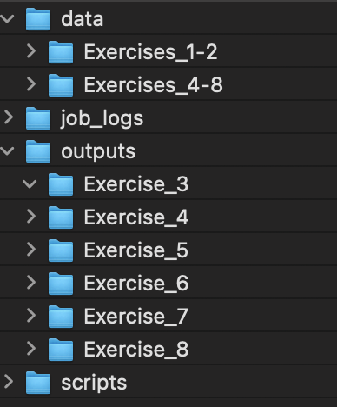
Data structure

Slide 27
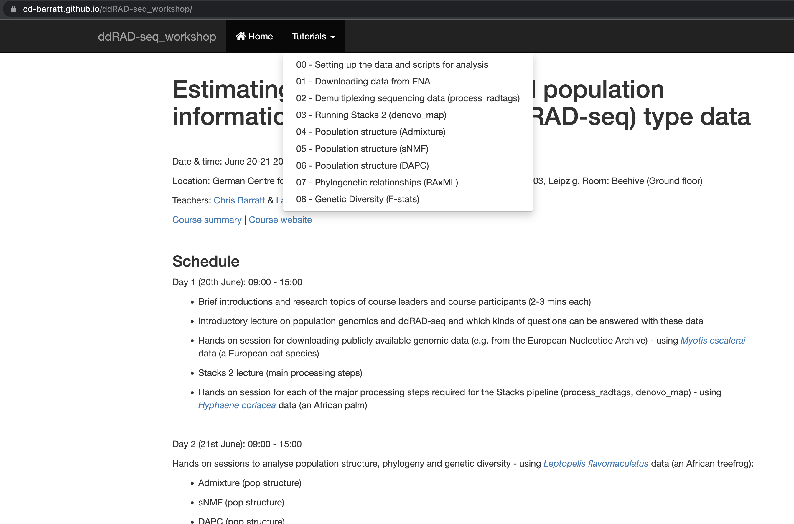
Tutorials
Go here: https://cd-barratt.github.io/ddRAD-seq_workshop/

Slide 28
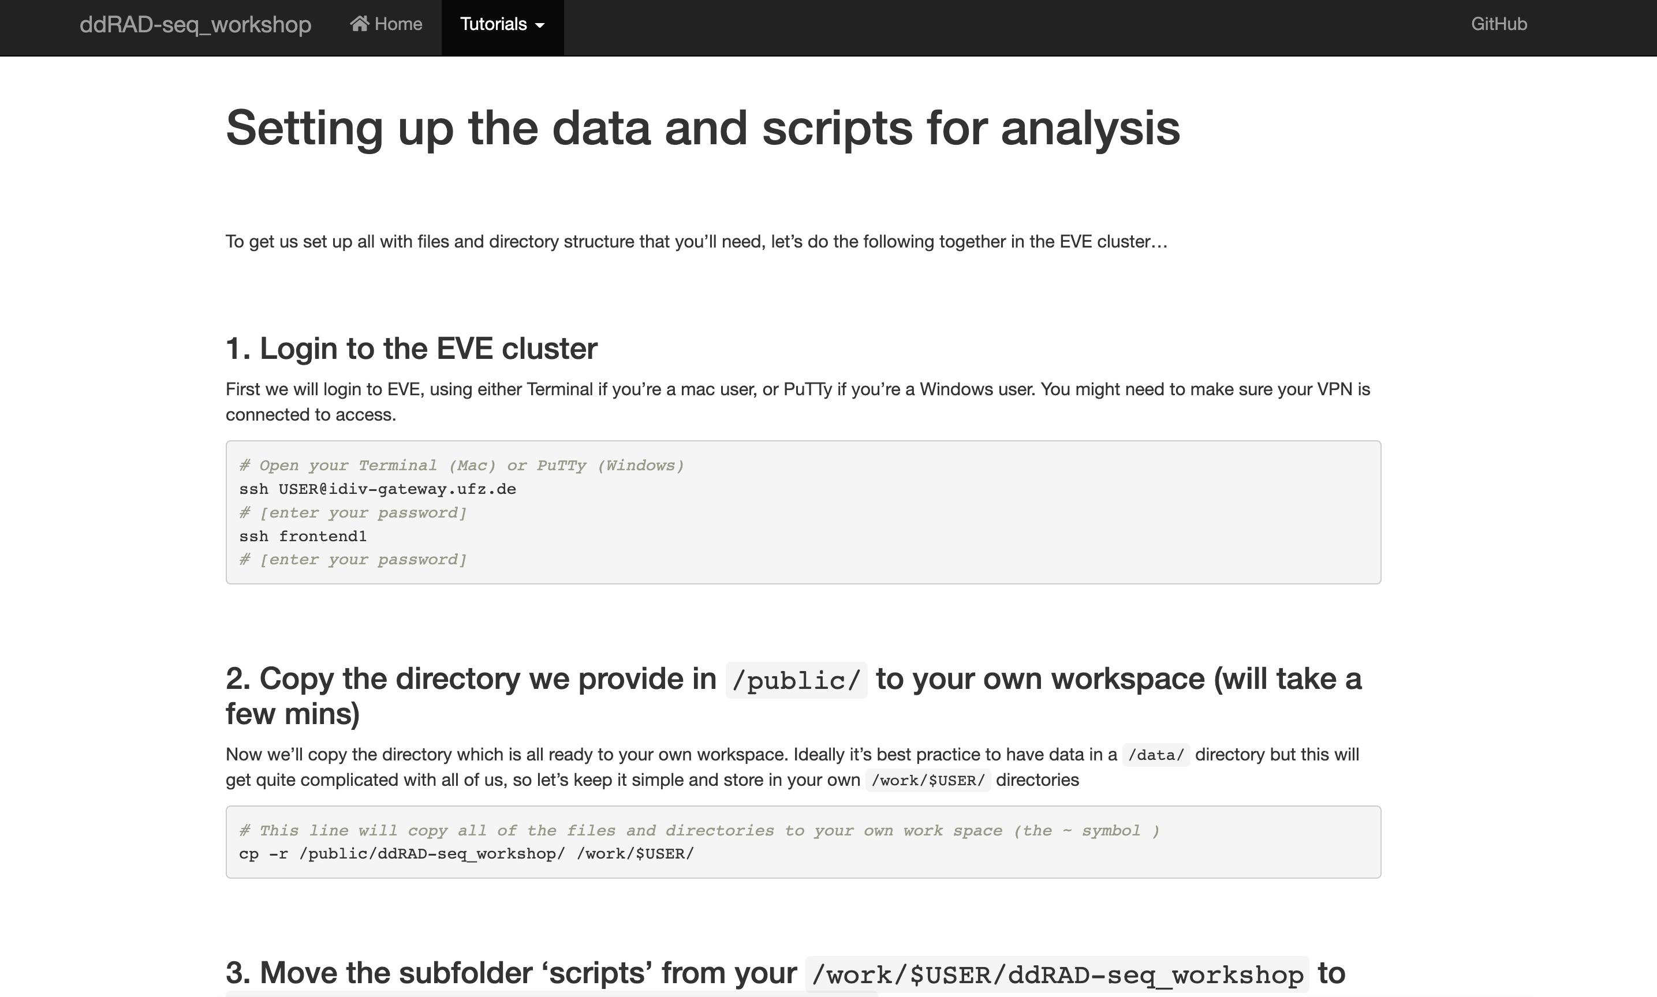
00 - setup

Slide 29
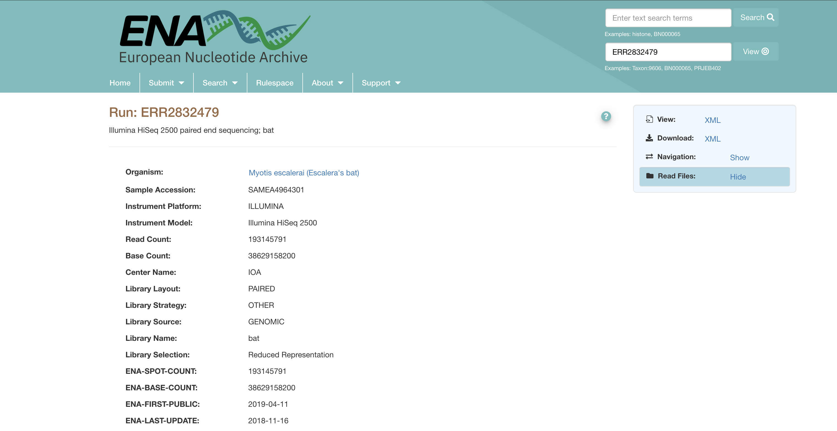
01 – Downloading data

Slide 30
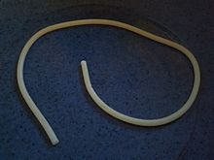
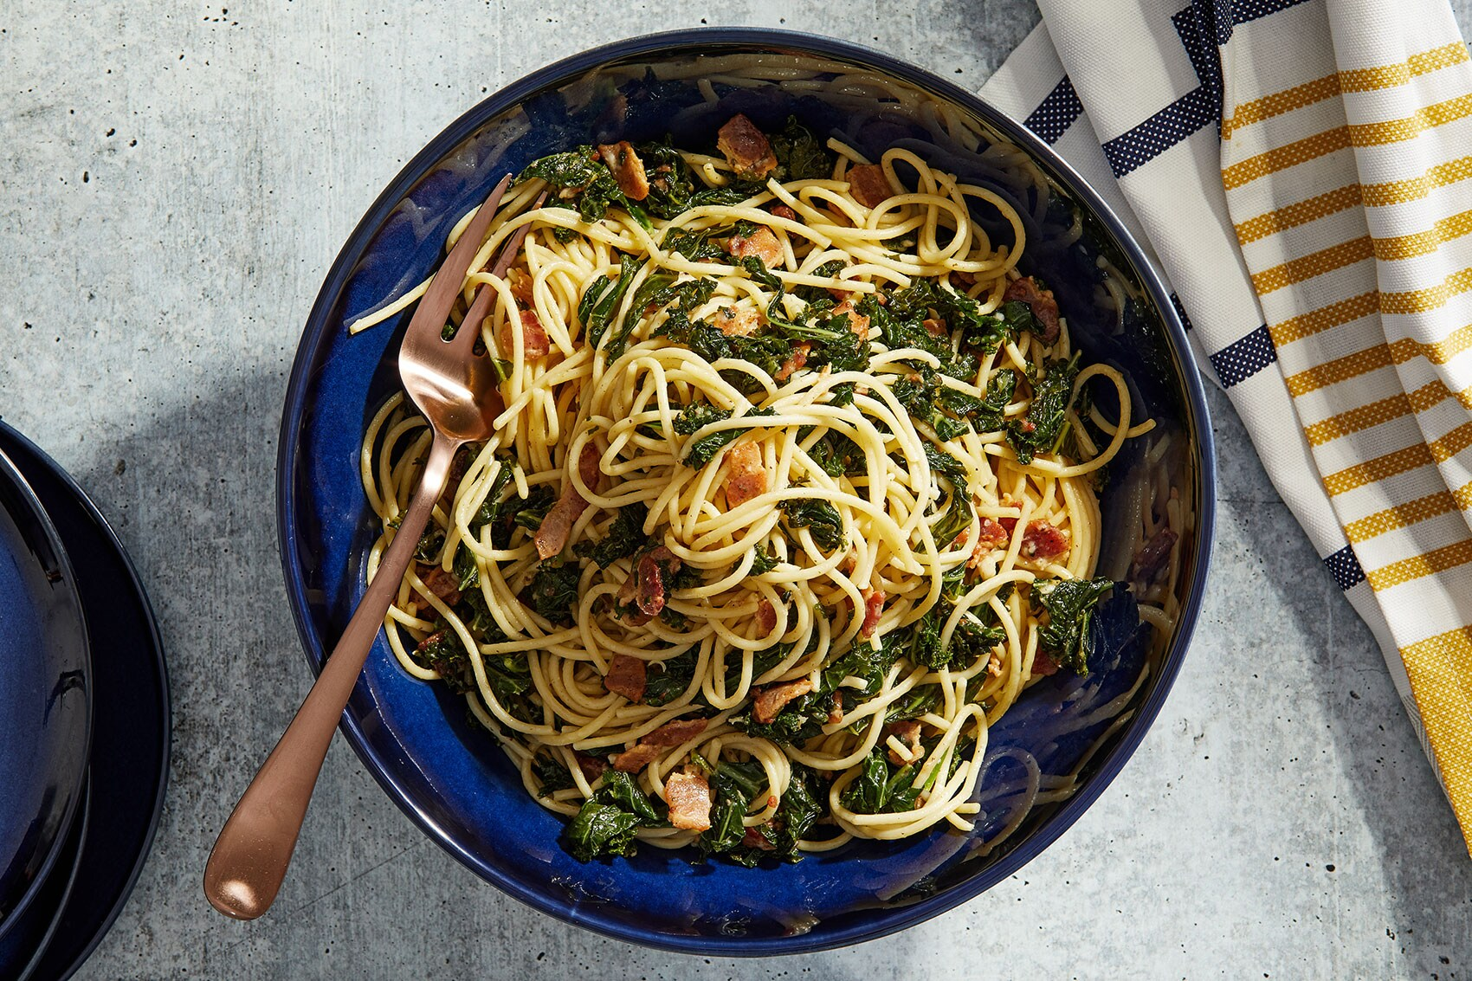
02 – process_radtags

Slide 31
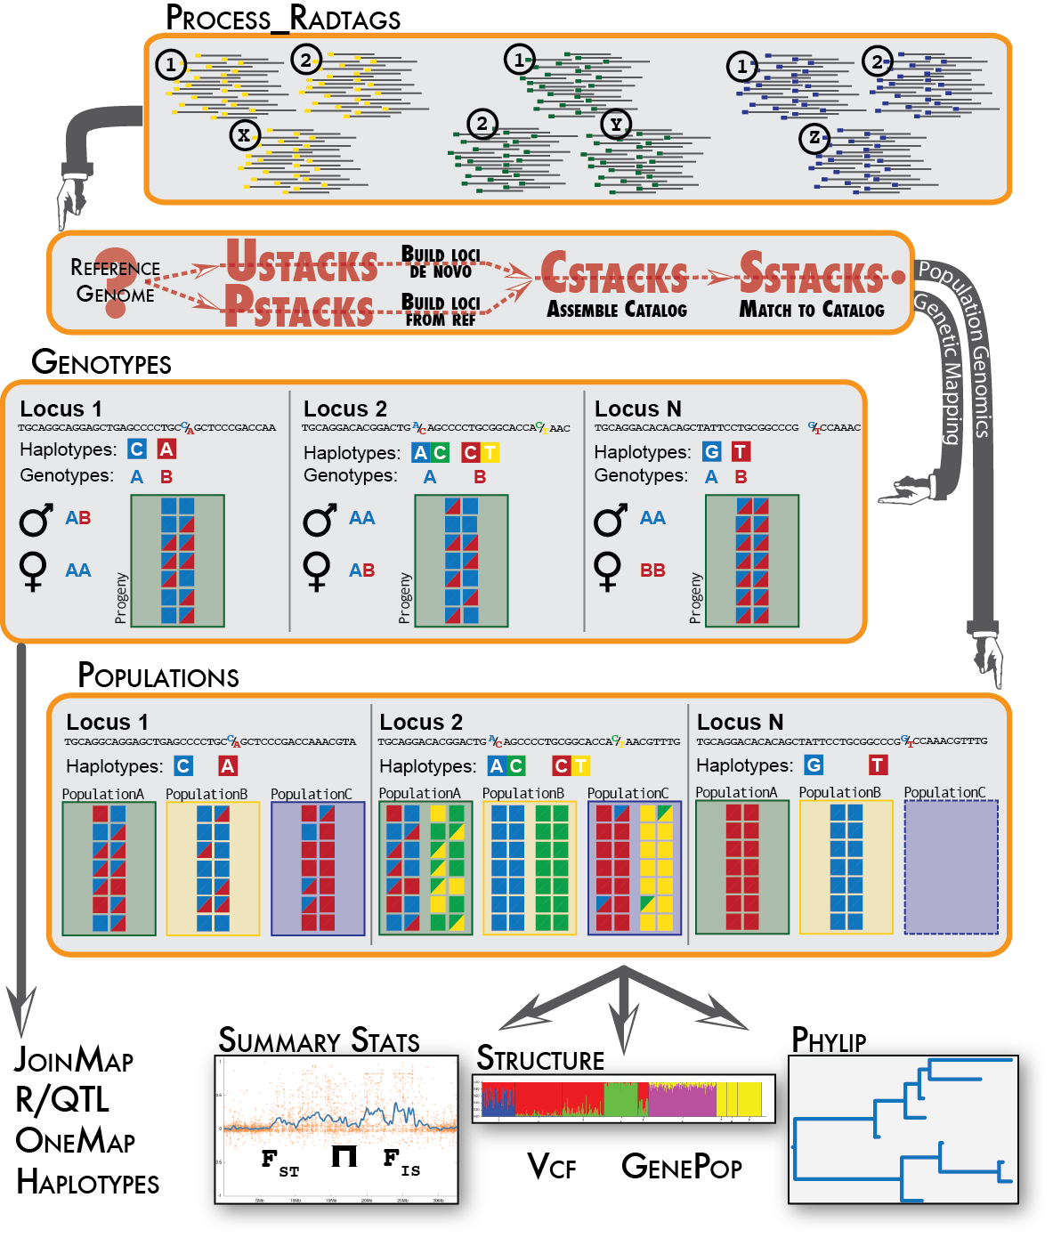
03 – denovo_map

Slide 32
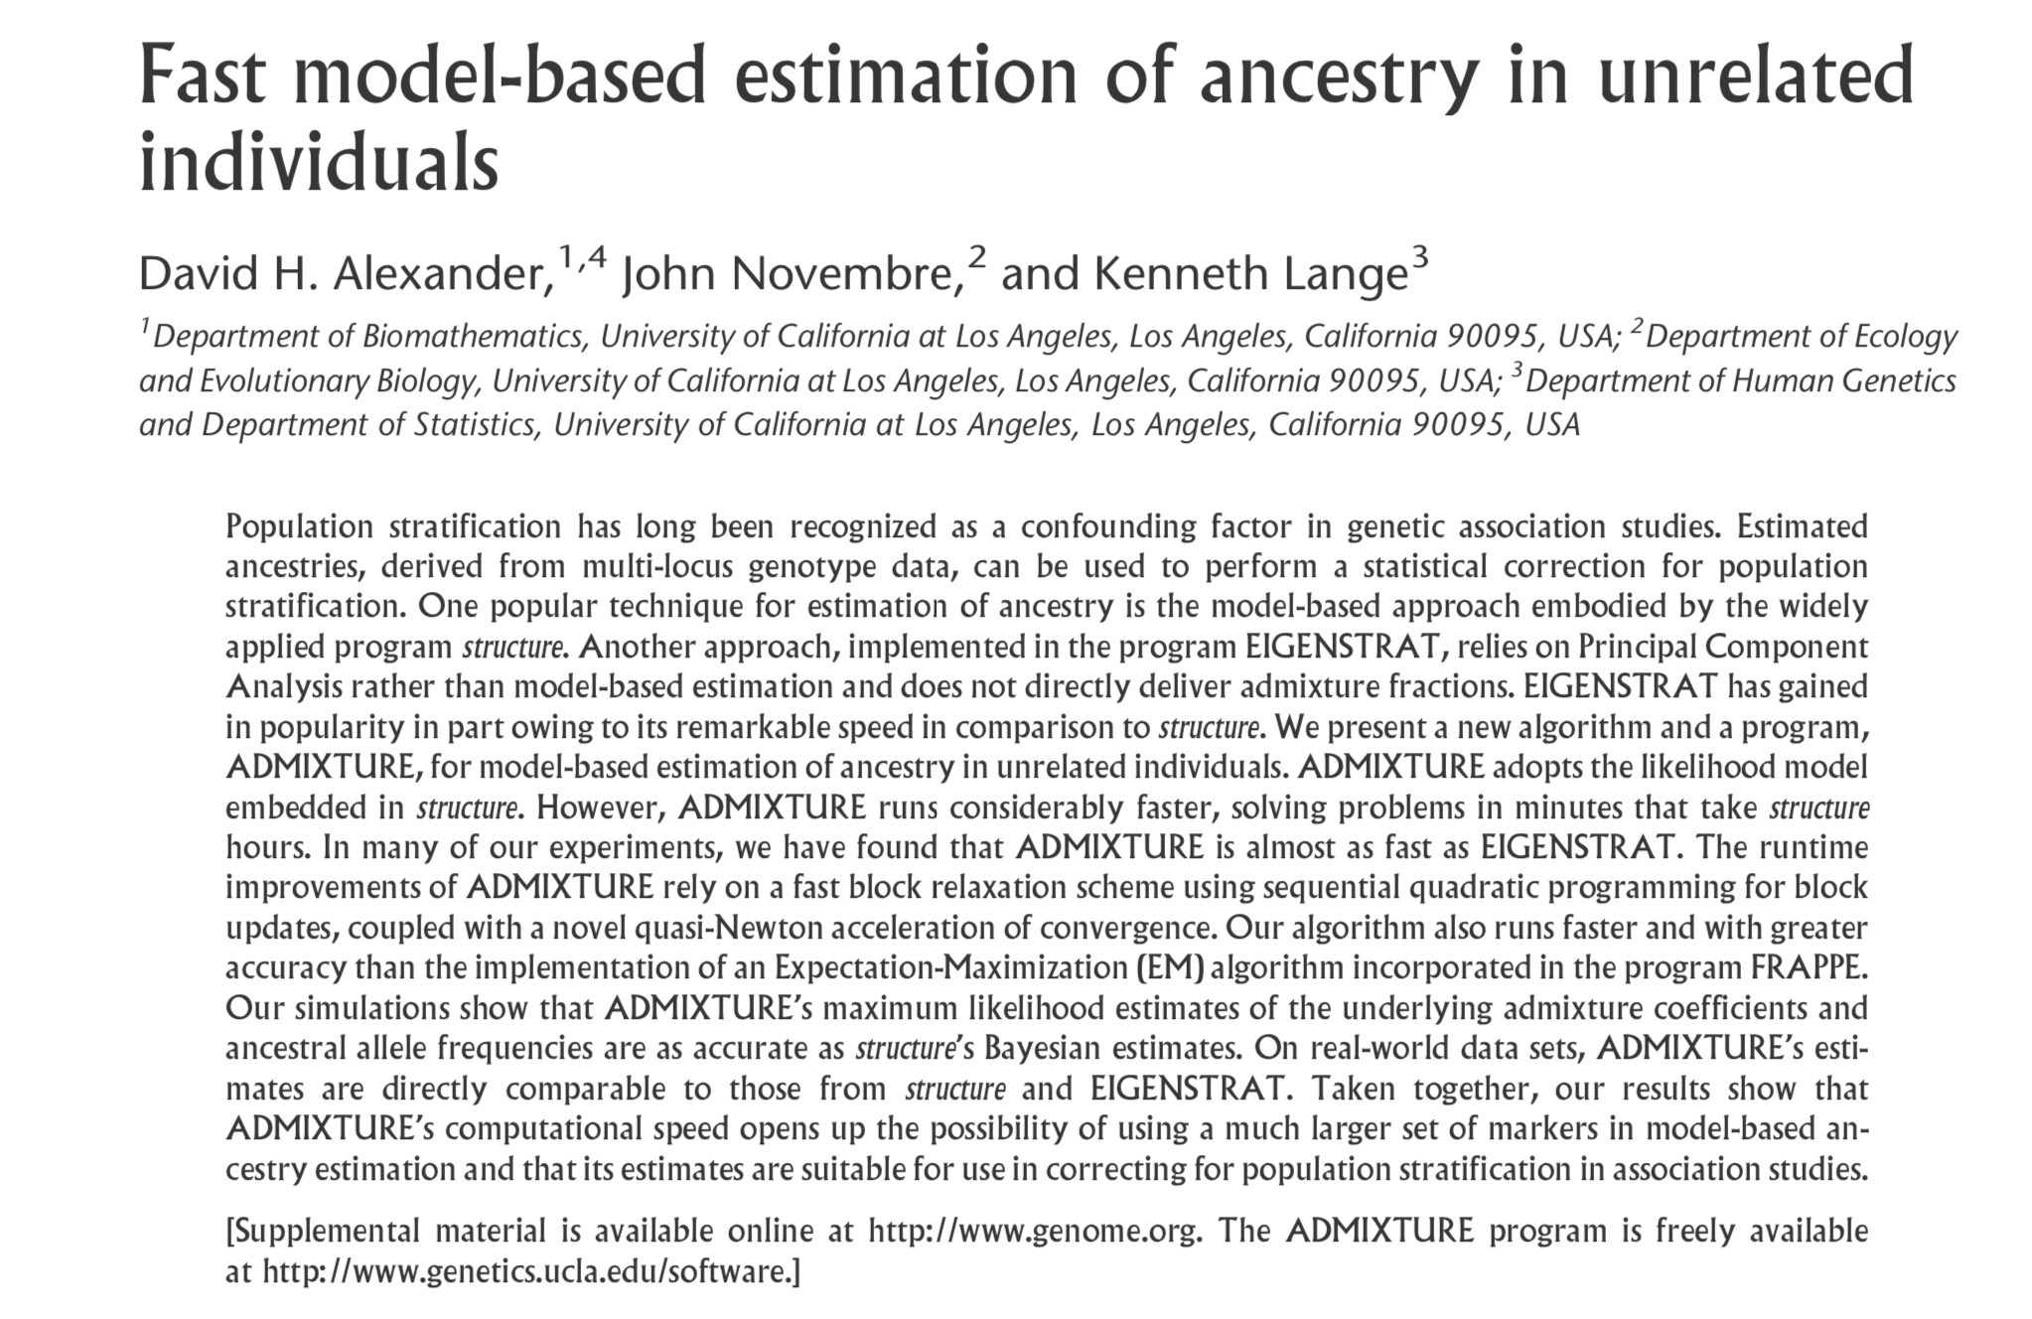
04 - Admixture

Slide 33
04 - Admixture
ML estimation of individual ancestries from SNP datasets
Uses same statistical model as Structure (Pritchard, Stephens & Donnelly, 2000) – the benchmark for understanding pop structure the past 20 years
Uses a block relaxation approach for speed, which outperforms the other methods – they simply become inefficient and intractable for large SNP data

Slide 34
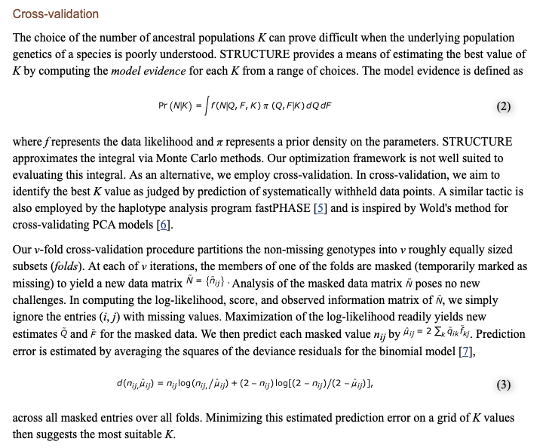
04 - Admixture

Slide 35
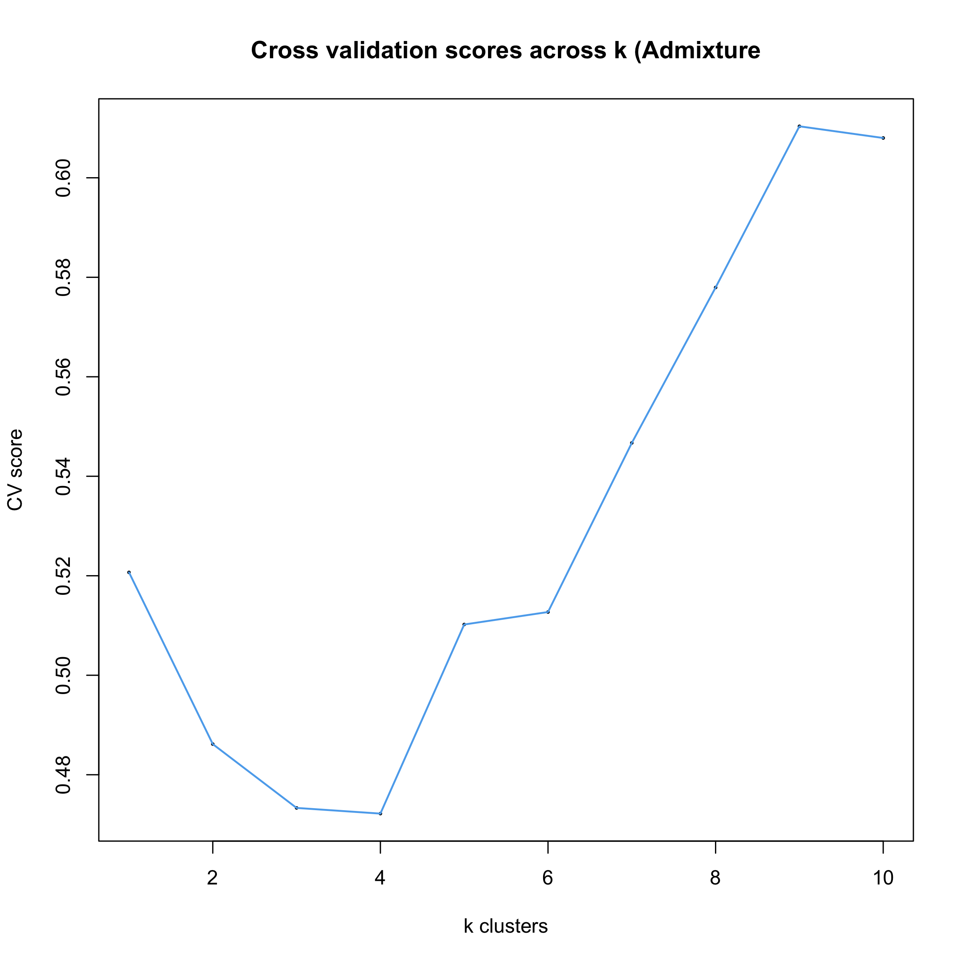
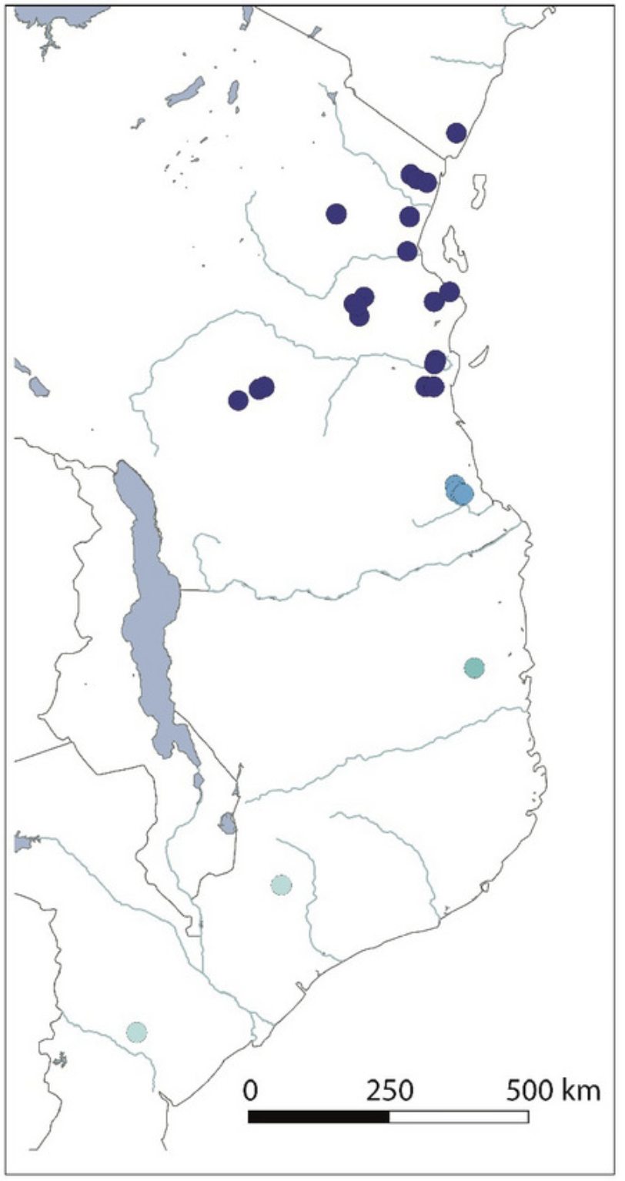
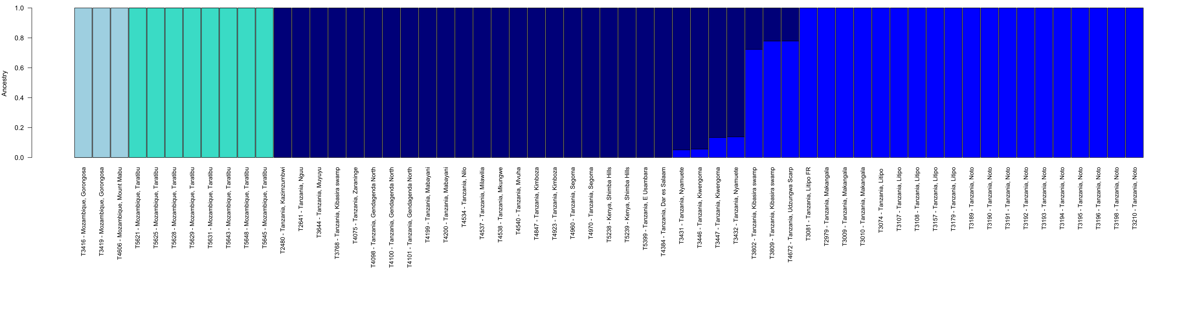
04 - Admixture

Slide 36
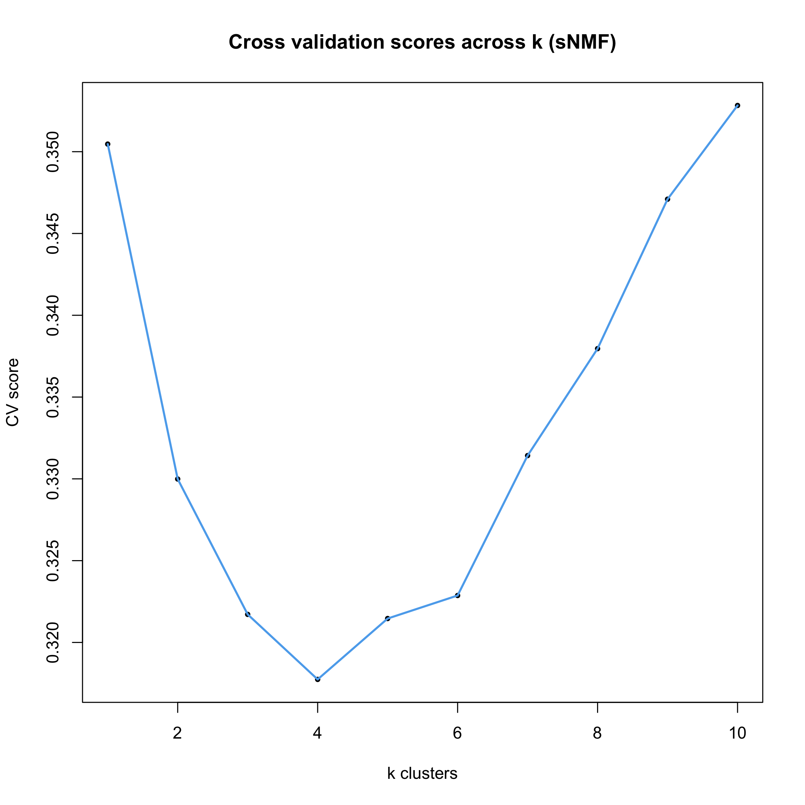
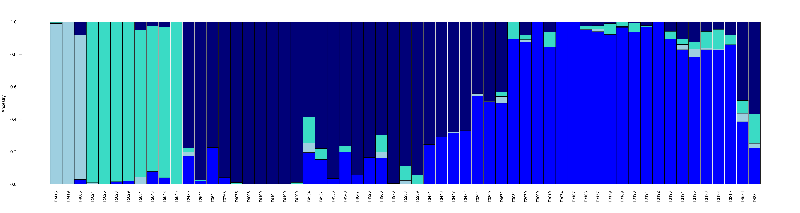
05 - sNMF

Slide 37
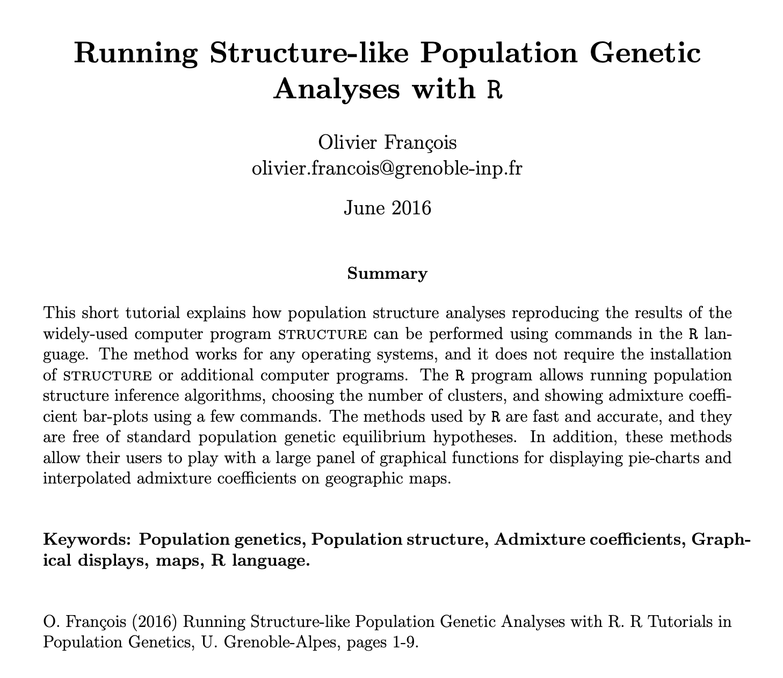
05 - sNMF

Slide 38
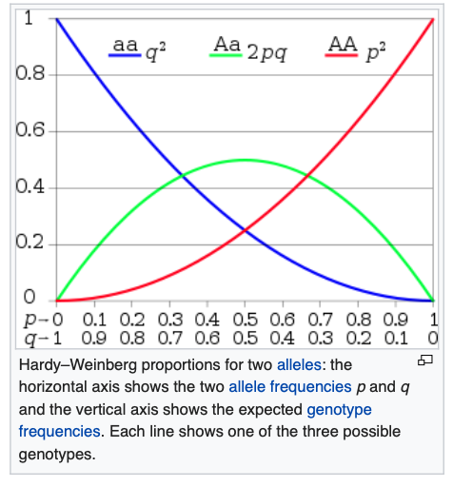
06 - DAPC
Hardy-Weinberg principle:
Allele and genotype frequencies will remain constant from generation to generation without external evolutionary influences
Selection
Mutation
Gene flow (migration)
Genetic drift random changes (e.g. small population sizes)

Slide 39
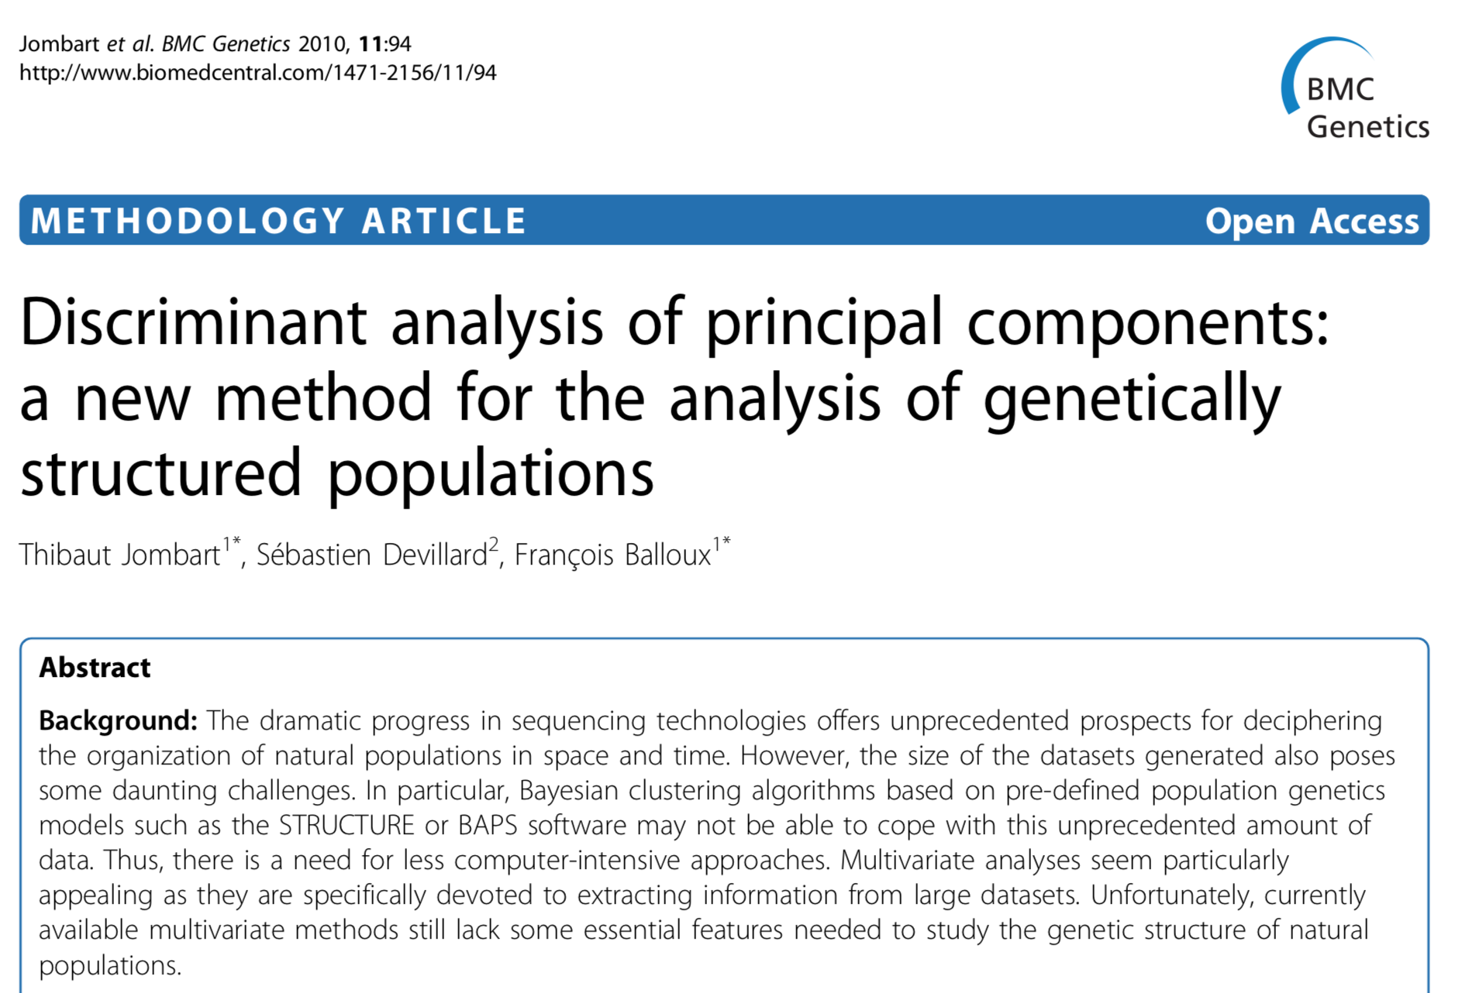
06 - DAPC

Slide 40
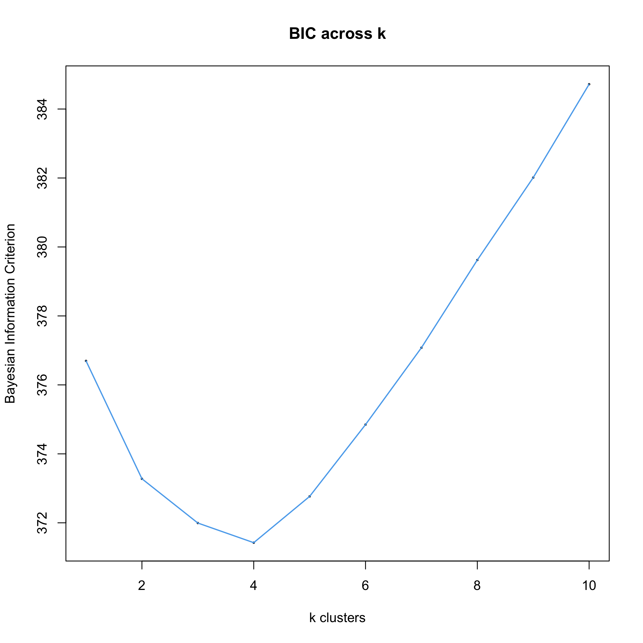
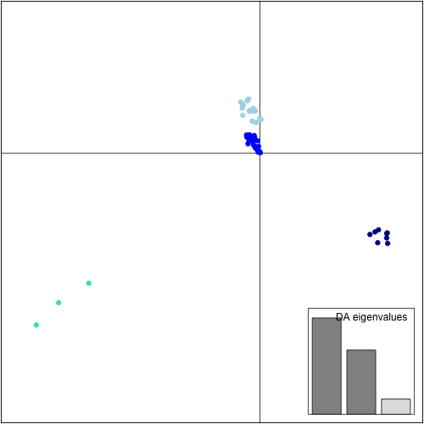
06 - DAPC

Slide 41
Summary of pop structure
Admixture, sNMF and DAPC analyses suggest k=4…
1 isolated cluster towards southern Mozambique
1 cluster in northern Mozambique
1 cluster in southern Tanzania
1 large cluster in northern Tanzania and Kenya

Slide 42
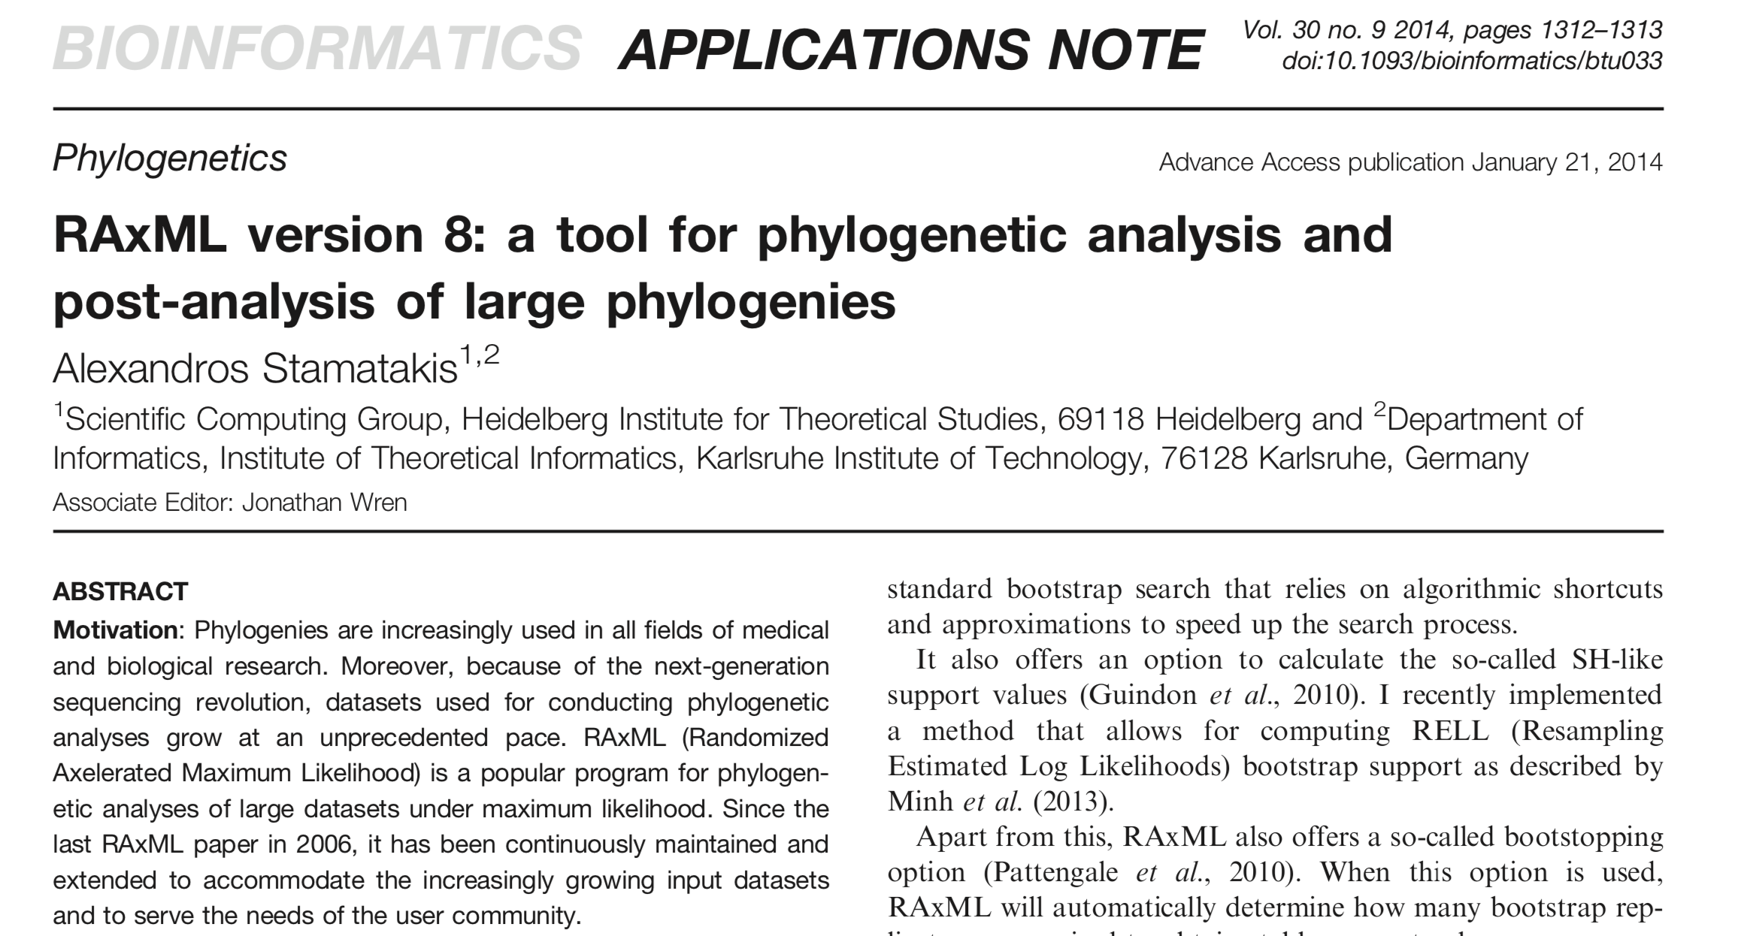
07 - RAxML

Slide 43
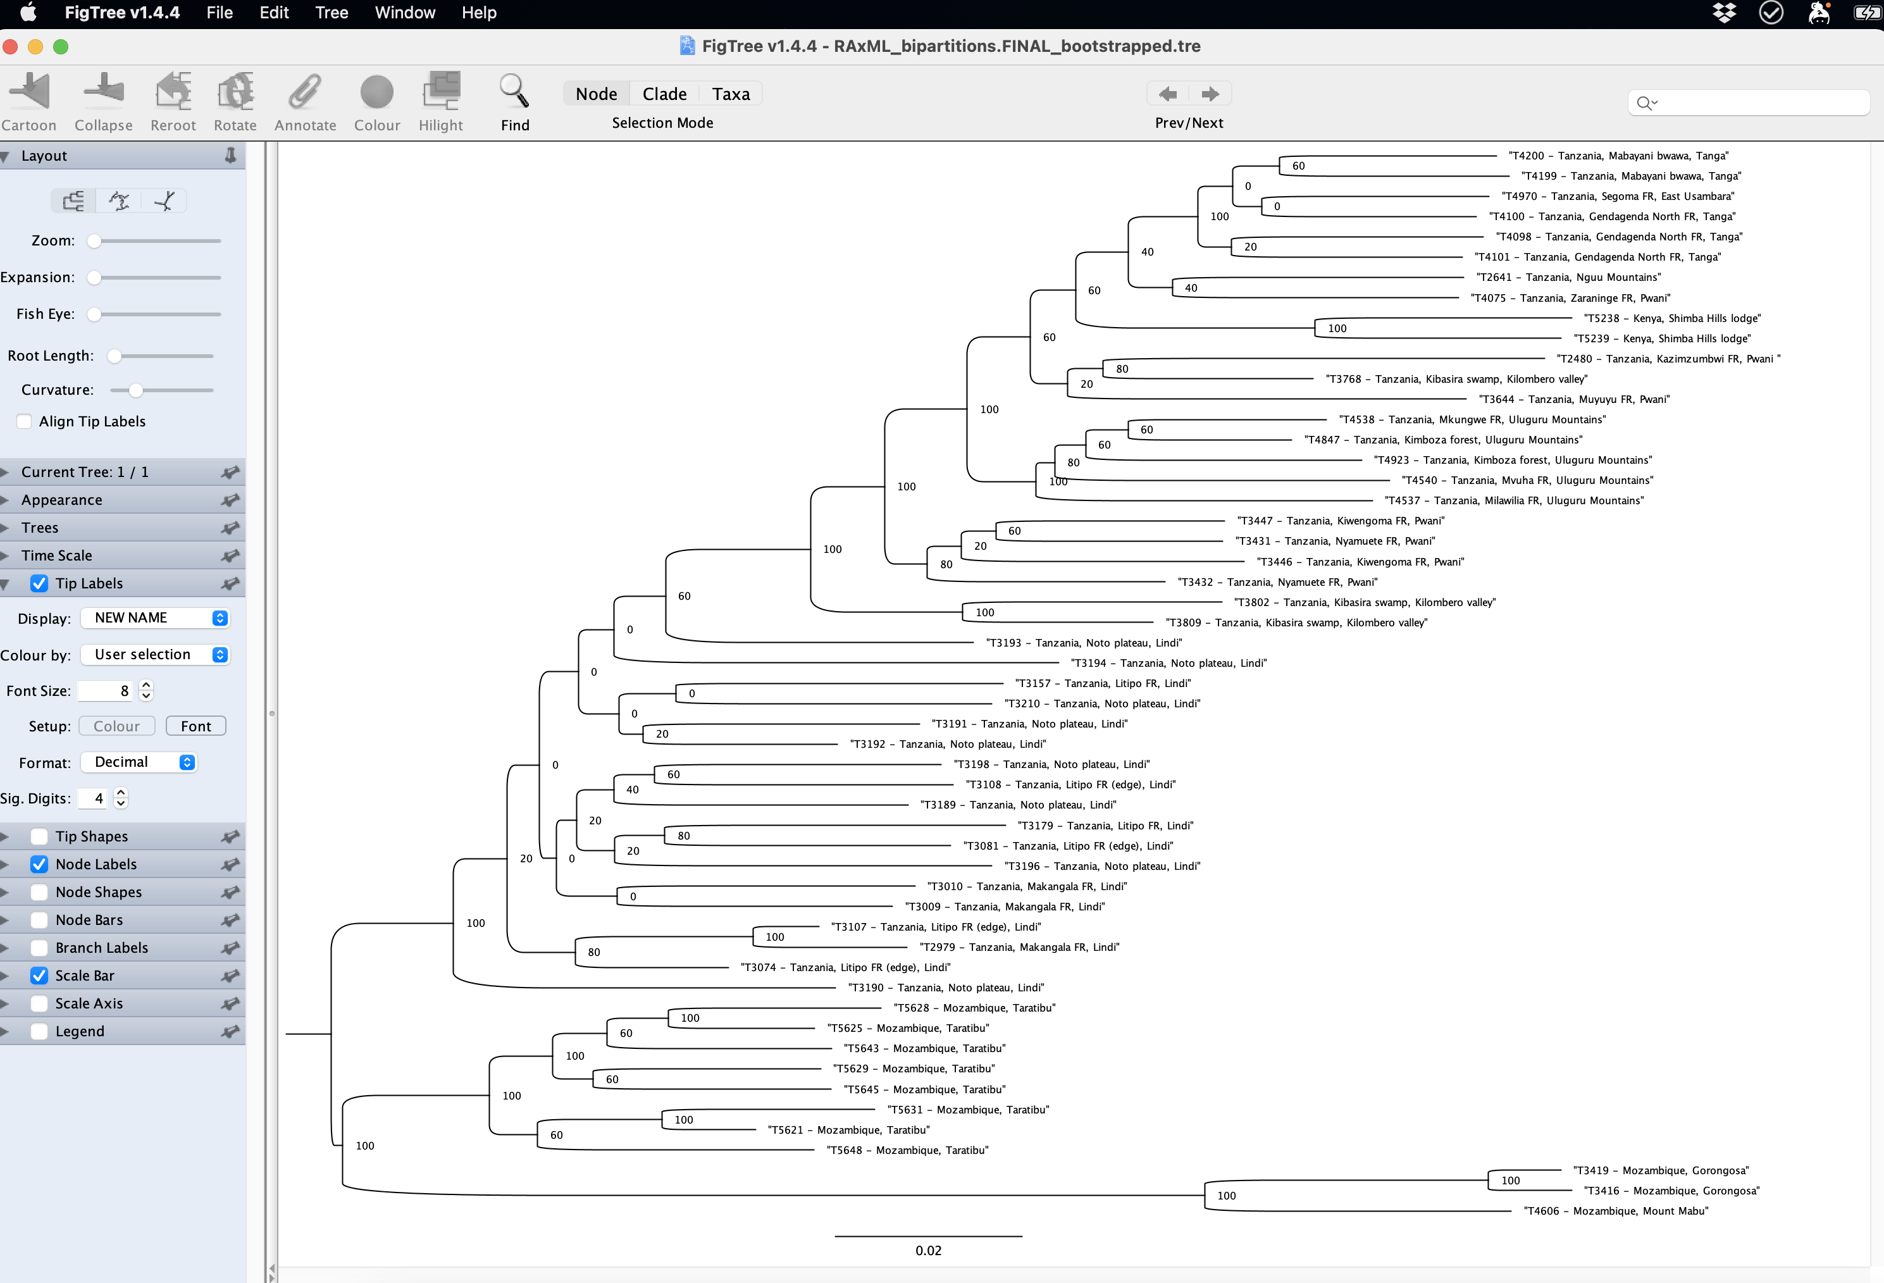
07 - RAxML

Slide 44
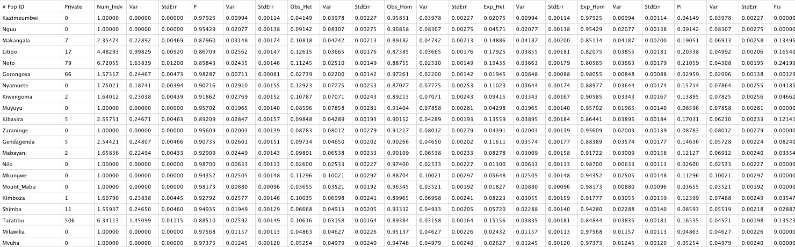

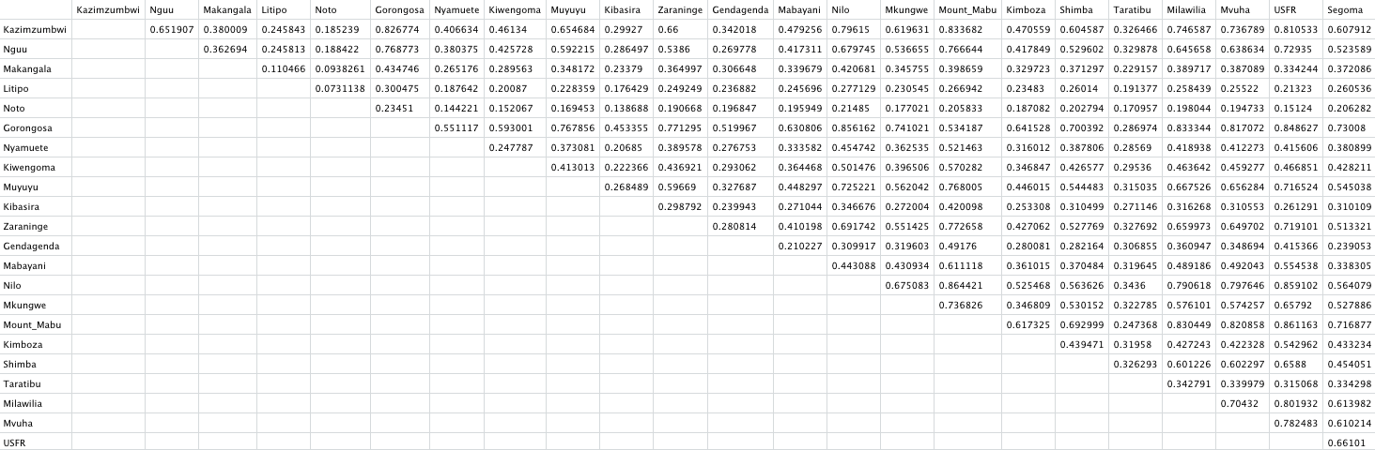
08 – Genetic diversity and FST

